Slide 1

Create and Find Free Game Assets
Bret Stateham BretStateham.com @BretStateham

Slide 2
Overview
Finding
Assets
Creating Sounds & Music
Creating Graphics

Slide 3
HAVE FUN!!!!!

Slide 4
http://msdnevents.com/gameon/resources.htm

Slide 5
Finding Assets

Slide 6
Lots of great resources on the net…
Graphics
2dgameartforprogrammers.blogspot.com
OpenGameArt.org
office.microsoft.com/images
www.lostgarden.com
freegamearts.tuxfamily.org
letsmakegames.org
bing it!
Sounds
freesound.org
pdsounds.org

Slide 7
!
HOLD
ON
NOW
.
.
.
IS
THAT
LEGAL
?

Slide 8
DOUBLE CHECK THE LICENSE!!!

Slide 9
Finding Free Assets

Slide 10
Creating Sounds & Music

Slide 11
Game Sounds
Sound Effects
Short sounds
Non-Repeating
Background Music
Typically longer
Repeat (loop)

Slide 12
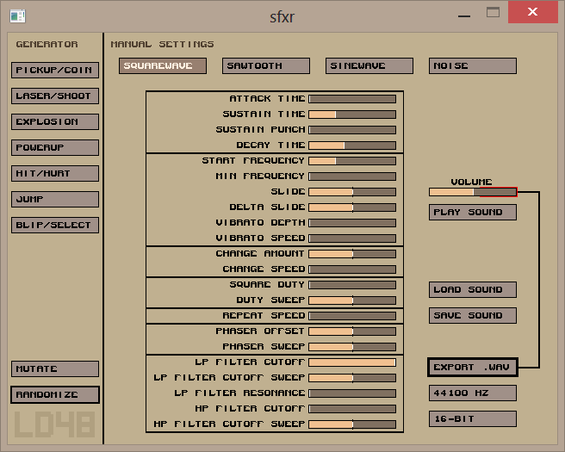
Tomas Pettersson’s sfxr
sfxr
drpetter.se

Slide 13
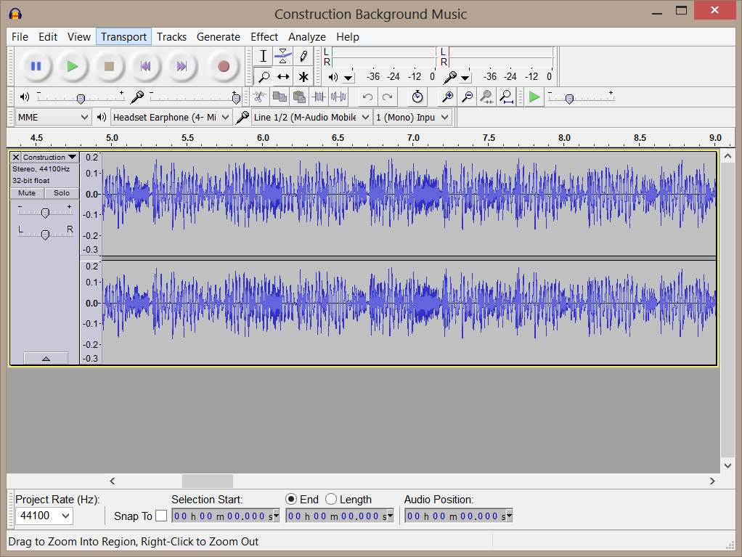

Audacity Waveform Editor
audacity.sourceforge.net

Slide 14
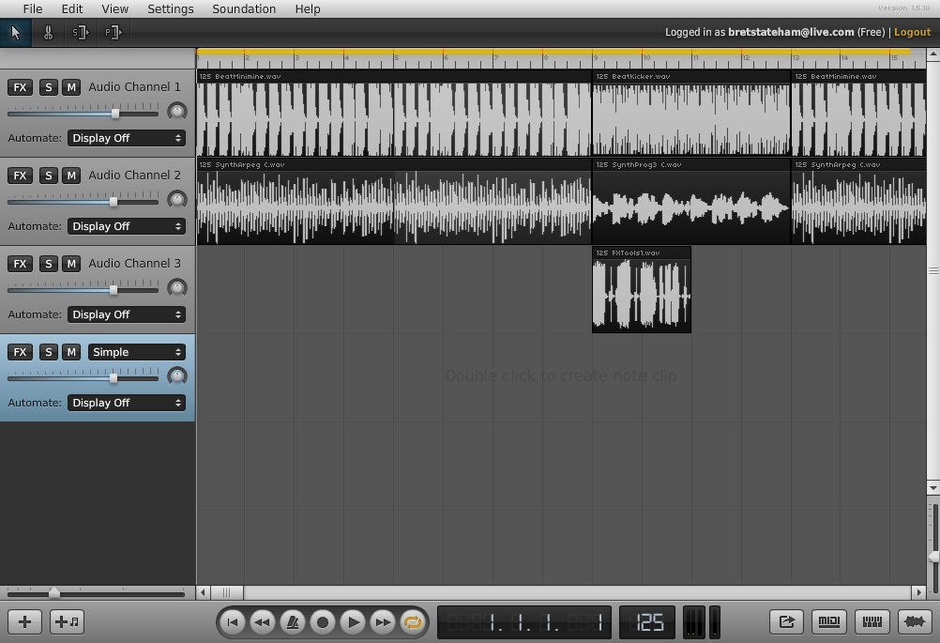
Soundation Sequencer
soundation.com

Slide 15
Creating Sounds

Slide 16
Creating Graphics

Slide 17
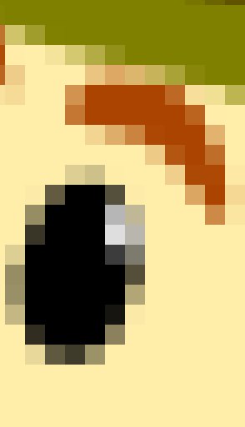



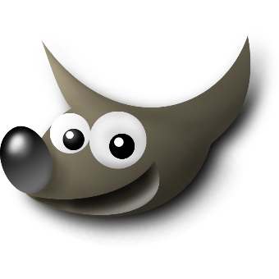
What are Bitmap Images?
Bitmaps describe the individual pixels in an image and their colors.
They are created at a specific size (pixels wide * pixels high)
They can be scaled down, extra pixels can simply be discarded
They don’t scale up well. New pixels have to be created from scratch
End up looking “blocky” or “pixelated” when they are scaled too big
JPG, PNG, BMP, & GIF, are common bitmap file formats
You edit Bitmap images with tools like Gimp, Photoshop, etc.

Slide 18
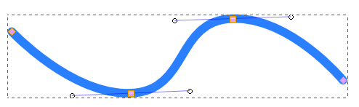

What are Vector Images?
They describe the various shapes in an image using “Vectors”
Vectors describe the shape, color, thickness, ends, etc of each line
They can be edited, reshaped, & scaled down or up without loosing quality
AI, CDR, WMF, EMF, and SVG are common vector file formats
You edit vectors with Corel Draw, InkScape, Illustrator, etc.
They can be exported to a bitmap format at a specific desired size

Slide 19



Transparency in Images (JPG vs PNG)
JPGs don’t support transparency
PNGs do!
Checkerboard is the “Background”

Slide 20
So…. what are JPGs good for?

Slide 21

Backgrounds!
Any large images
that don’t need transparency!

Slide 22
What about PNGs?

Slide 23


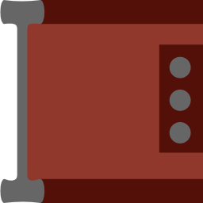
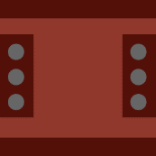


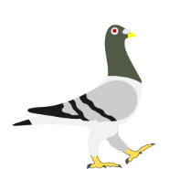
Everything else!

Slide 24

My InkScape Character Template
Based on Chris Hildebrand’s work: 2dgameartforprogrammers.blogspot.com
Segmented – Each body part is separate
Articulated – Arms & Legs
Grab it from http://aka.ms/bsct
Save to .svg template files to: “C:\Program Files (x86)\InkScape\Share\Templates”

Slide 25
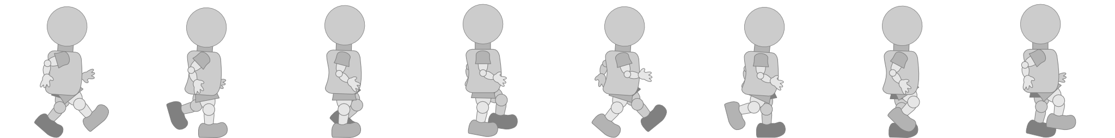
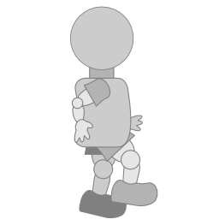
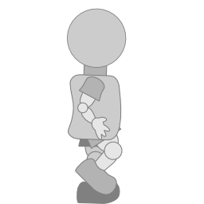
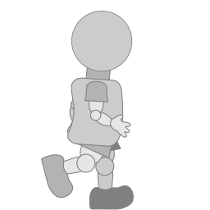
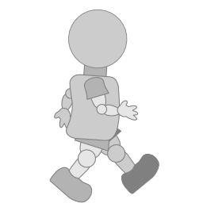
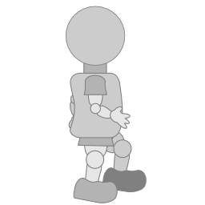
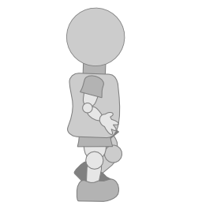
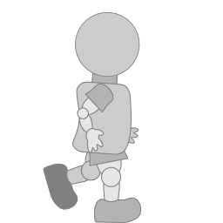
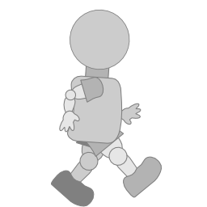
Sprite Sheets
A single image with multiple “sub-images”
Great for animations, or simply sprites that have different states
PLAY

Slide 26
Creating Graphics

Slide 27
Review
Finding
Assets
Creating Sounds & Music
Creating Graphics

Slide 29
Game On Graphical Assets

Slide 30
Section Header Sample
Edit or delete this slide

Slide 31
Standard Title & Content Slide
Content goes here
No duh!

Slide 32
Sample Demo Slide Demo Something Awesome here!

Slide 33
Devices

Slide 34
YoYo Games Logo

Slide 35

GameMaker: Studio Logo

Slide 36



InkScape, Gimp & Audacity Logos

Slide 37
Windows 8 Games Tile / Icon

Slide 38
HTML5 Icons

Slide 39
Windows 8 Tiles

Slide 40
Tile Icons – Page 1

Slide 41
Tile Icons – Page 2
DB

Slide 42
Slate

Slide 43
Hands

Slide 44
Touch Gestures
Press and Hold to Learn
Tap for Primary Action
Slide to Drag
Swipe to Select
Pinch to Zoom
Swipe from Edge
Rotate to Rotate

Slide 45
Windows Phone

